Slide 1
Chapter 1: Introduction to Analog Design
1.1 Why Analog?
1.2 Why Integrated?
1.3 Why CMOS?
1.4 Why This Book?
1.5 Levels of Abstraction

Slide 2
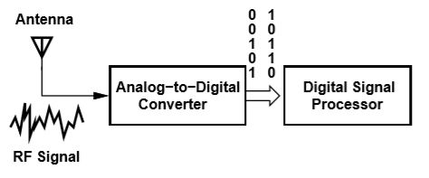
Sensing and Processing Signals
Many electronic systems sense (receive) a signal and then process and extract information from it.
Processing preferably occurs in digital domain.
Sensing interface still demands high performance analog design.

Slide 3
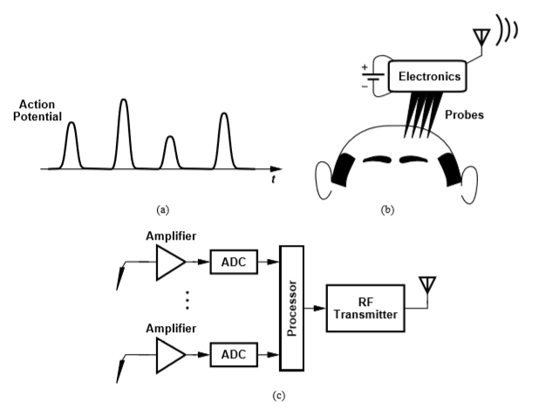
Sensing and Processing Signals
Neural activity generates electric pulses a few mV high and a few 100 µ-seconds long.
Signal produced by probes monitoring activity must be amplified, digitized, and transmitted wirelessly.
Need low power electronics for this application.
Analog circuits consume most of the power in a system.

Slide 4
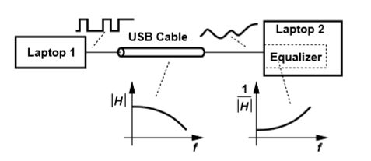
When Digital Signals Become Analog
Equalization to compensate high-frequency attenuation in a USB cable.
An analog equalizer is more efficient than an ADC at very high data rates (e.g. tens of gigabits per second).
Conversely, at lower speeds it is more efficient to digitize the signal and perform required functions in digital domain.

Slide 5
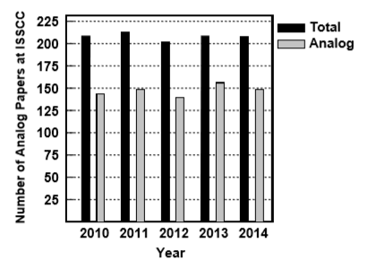
Analog Design is in Great Demand
Although analog circuits are typically quite less complex than digital circuits, the majority of papers belong to analog design.
Design challenges include transistor imperfections, declining supply voltages, power consumption, circuit complexity, and PVT variations.

Slide 6
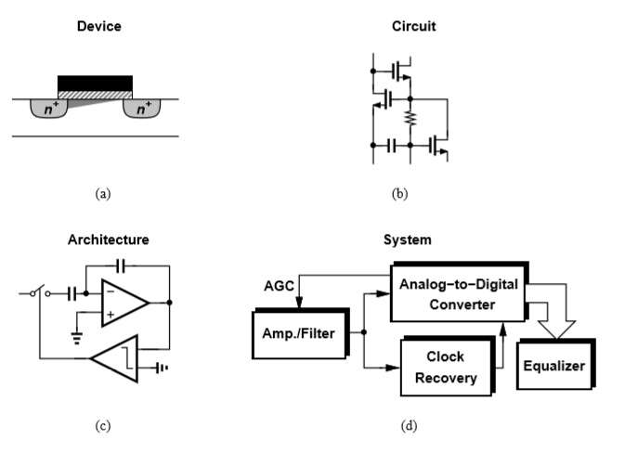
Levels of Abstraction
Switching between levels of abstraction is necessary for
  - understanding the details of operation.
  - optimizing the overall performance.
Interaction between all groups in industry is essential for high performance and low cost designs.

